Slide 1
IBM University Engagement Project Submission
“Exploring the Power of Agentic AI with IBM Granite and LangFlow”

Slide 2

Project Tile – EduSimplify AI – AI-Powered PDF Learning Assistant using IBM watsonx.ai Granite Models
Domain of Project – Education Technology
Student Name | Recent Passport Photo | Email ID | Mobile number [WhatsApp]
M. ABHIRAM REDDY |  | 2420080067aids@gmail.com | 9090023535

Slide 3
Problem Statement -
Project Overview
EduSimplify AI is an AI-powered PDF learning assistant that enables students to upload academic documents and ask questions in natural language. Using Retrieval-Augmented Generation (RAG) and IBM Granite models on IBM watsonx.ai, the system provides accurate, context-aware answers based solely on the uploaded PDF, making learning faster and more interactive.
Problem Statement
Students spend significant time searching through lengthy PDFs, lecture notes, and research papers for specific information. Traditional PDF readers rely on keyword searches, while general AI chatbots may produce inaccurate responses due to the lack of document context. There is a need for an intelligent AI assistant that understands uploaded documents and delivers reliable, document-based answers.
Objective
Develop an AI-powered educational assistant that:
Enables students to upload PDF documents.
Extracts and processes document content.
Uses RAG for intelligent context retrieval.
Generates accurate answers using IBM Granite.
Provides an interactive AI chat interface.

Slide 4
Proposed Solution -
EduSimplify AI is a web-based AI learning assistant that transforms static PDF documents into an interactive question-answering system.
After uploading a PDF, the application extracts text using PyMuPDF, divides the content into smaller chunks, and stores them temporarily in memory.
Whenever a student asks a question, the backend retrieves the most relevant document chunks and sends them, along with the user's query, to IBM Granite through IBM watsonx.ai.
The Granite model generates responses strictly based on the retrieved document context, significantly reducing hallucinations and improving answer accuracy.
The complete workflow is implemented using React, FastAPI, Python, and IBM Granite.

Slide 5
Technology Used
Frontend
React.js
Vite
CSS
Backend
FastAPI
Python
Artificial Intelligence
IBM watsonx.ai
IBM Granite 3.3 8B Instruct Model
PDF Processing
PyMuPDF (fitz)
RAG
Document Chunking
Context Retrieval
Prompt Engineering
Development Tools
Git
GitHub
Visual Studio Code
IBM Services Used
IBM watsonx.ai
IBM Granite Foundation Model
IBM Cloud Lite
IBM API Key Authentication

Slide 6
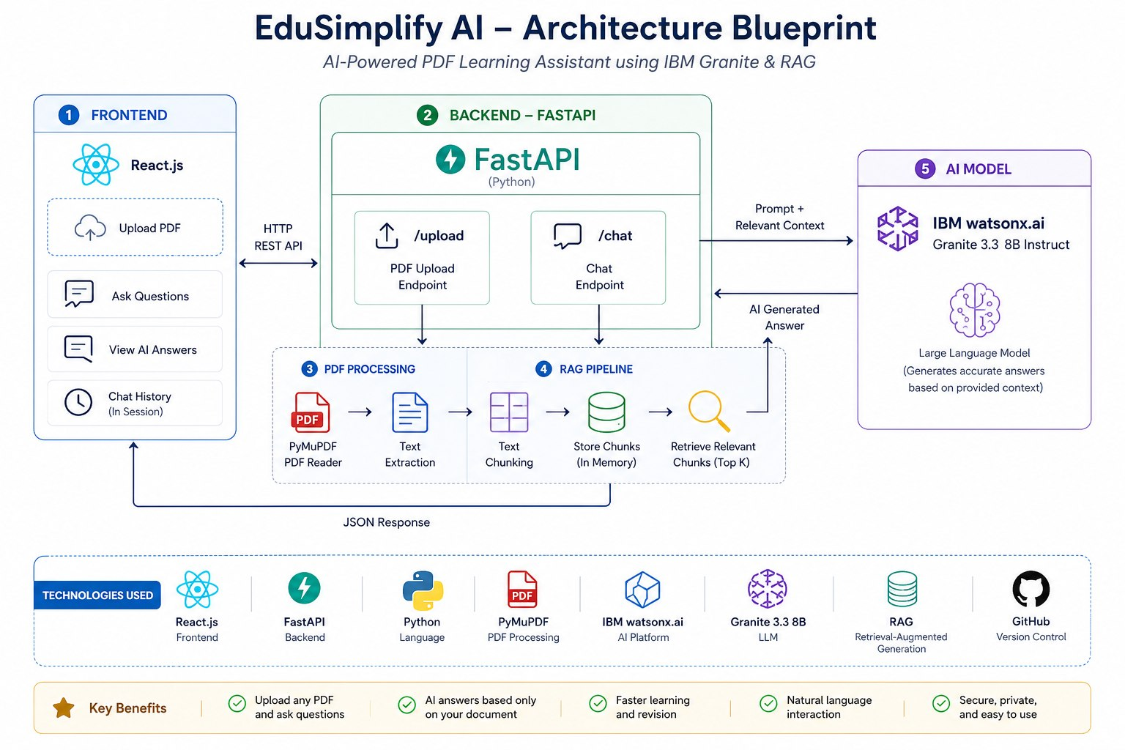
Architecture blueprint

Slide 7
Role of Agentic AI in the solution
EduSimplify AI utilizes an Agentic AI-inspired workflow to automate document understanding and intelligent question answering. When a user uploads a PDF, the system automatically extracts the text, preprocesses the content, and divides it into meaningful chunks using a Retrieval-Augmented Generation (RAG) approach. This enables the application to retrieve the most relevant information related to the user's query.
The retrieved document context is then sent to the IBM Granite foundation model hosted on IBM watsonx.ai, where the model performs natural language understanding, reasoning, and response generation. By generating answers only from the uploaded document, the system minimizes hallucinations and provides accurate, context-aware responses.
This intelligent workflow transforms static academic PDFs into an interactive learning assistant, allowing students to ask questions in natural language and receive instant, reliable answers. EduSimplify AI improves learning efficiency, reduces the time spent searching through lengthy documents, and demonstrates how IBM Granite and RAG can be effectively applied to build smart, AI-powered educational solutions.

Slide 8
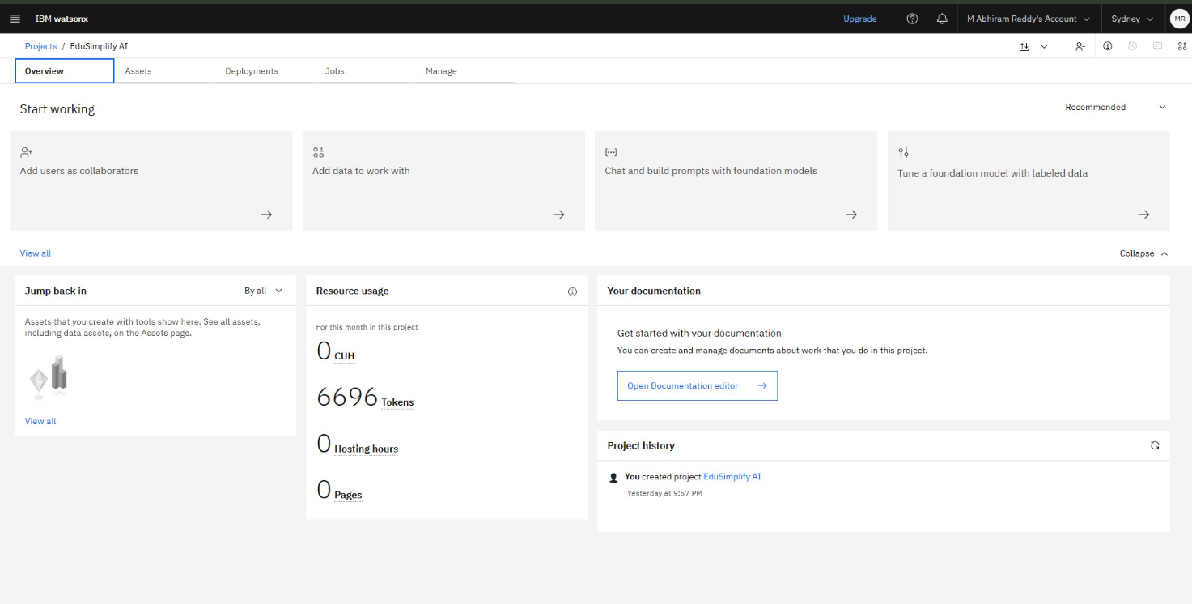
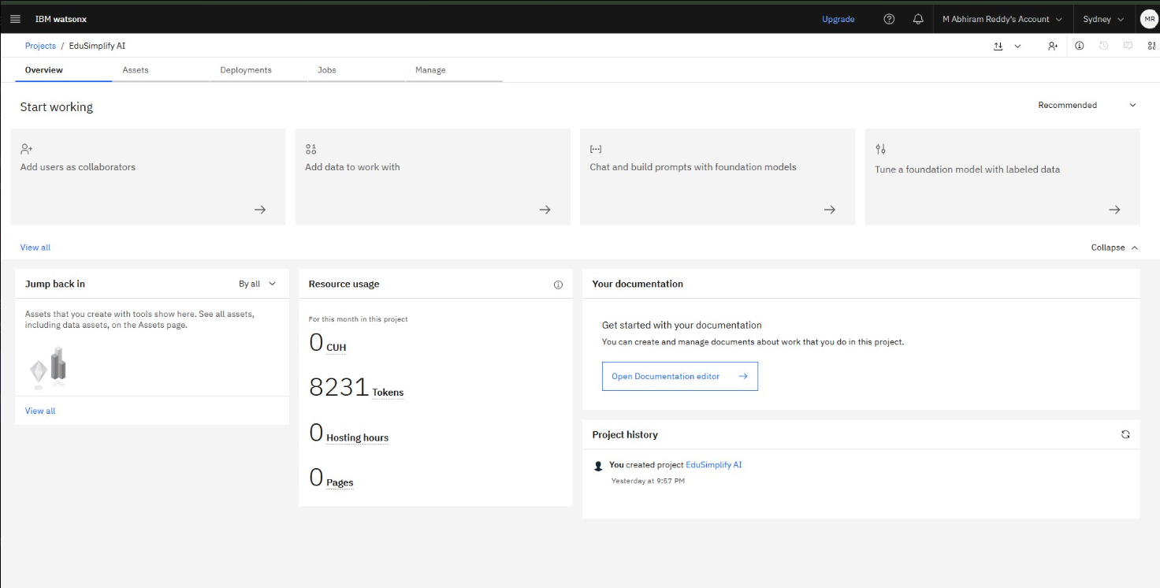
Token Usage
8231 token are used
Before Prompt
After the Prompt
·
·
·

Slide 9
Novelty and Uniqueness
AI-Powered Document Understanding – Enables users to ask questions in natural language instead of relying on traditional keyword-based PDF searches.
RAG-Based Context Retrieval – Retrieves only the most relevant document sections before generating responses, improving answer accuracy and reducing hallucinations.
IBM Granite Integration – Utilizes IBM Granite models through IBM watsonx.ai for advanced reasoning, summarization, and context-aware response generation.
Interactive Learning Experience – Converts static PDFs into an AI tutor that provides instant explanations, concept clarification, and academic support.
Modern Full-Stack Architecture – Built using React, FastAPI, Python, and IBM watsonx.ai, ensuring scalability, modularity, and seamless user interaction.
Improved Study Efficiency – Helps students quickly locate important information, saving time and enhancing productivity during exam preparation and revision.
User-Friendly Interface – Provides a simple, responsive, and intuitive platform for uploading PDFs and interacting with AI-powered document analysis.

Slide 10
Git Hub Link
https://github.com/abhi021410-ship-it/EduSimplify_AI.git
·
·
·

Slide 11
Future Scope
1. Multiple PDF Support
Enable users to upload and interact with multiple PDF documents simultaneously, allowing cross-document search and comparison for enhanced learning.
2. Vector Database Integration
Implement FAISS or ChromaDB to improve semantic search, enabling faster and more accurate retrieval from large collections of documents.
3. AI-Based Study Tools
Extend the application to automatically generate concise summaries, flashcards, quizzes, MCQs, and revision notes from uploaded PDFs.
4. Voice and Multilingual Support
Integrate speech recognition and multilingual capabilities so users can ask questions using voice commands and interact in different languages.
5. Cloud Deployment & User Management
Deploy the application on cloud platforms with secure user authentication, chat history, document management, and personalized learning dashboards for a complete AI-powered educational platform.
·
·
·

Slide 12
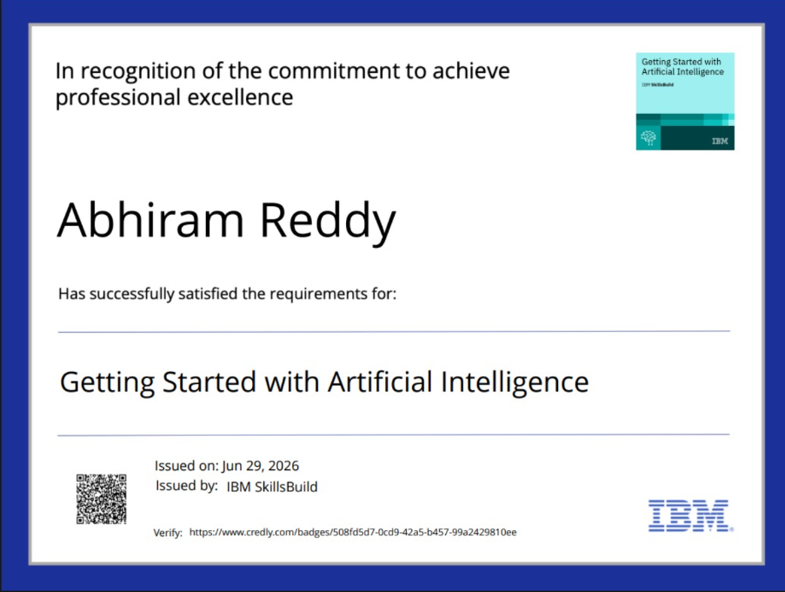
Certificates Earned:

Slide 13
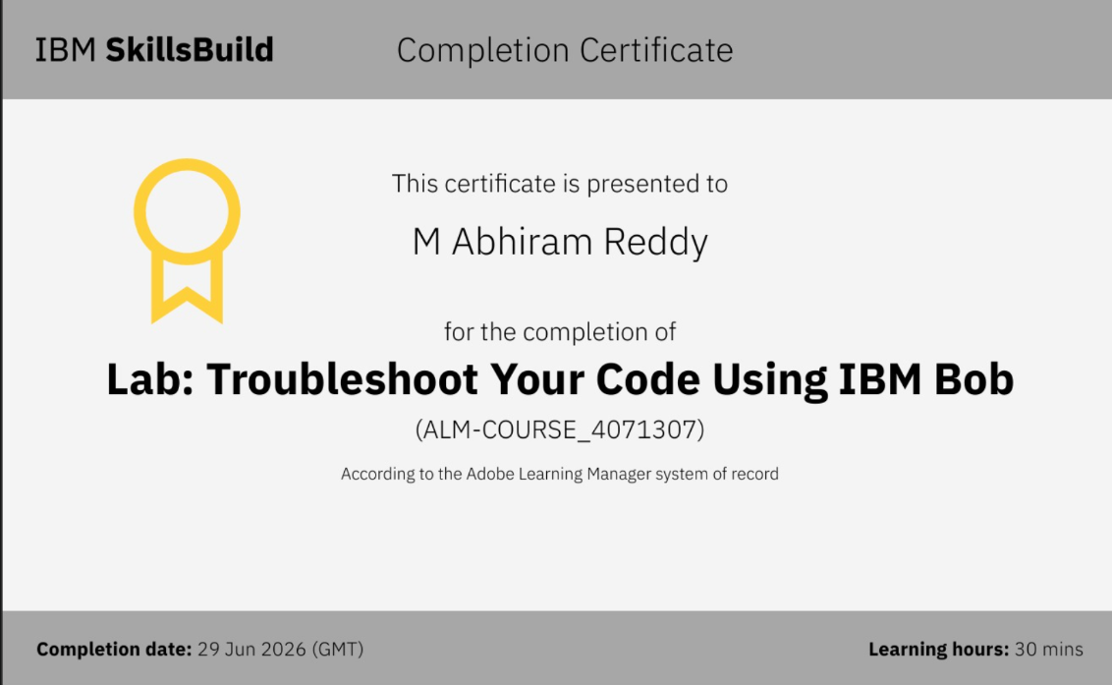
Certificates Earned:​

Slide 14


